Slide 1



IntentPay
No need to understand blockchain
Notes:
Hi everyone! Today I’m excited to introduce Intent Pay — a simple and easy way to access crypto payments and DeFi, even if you’ve never touched a wallet or used blockchain before.
By combining the power of World App, 1inch, and Circle, Intent Pay lets anyone pay or trade — with zero technical knowledge.

Slide 2
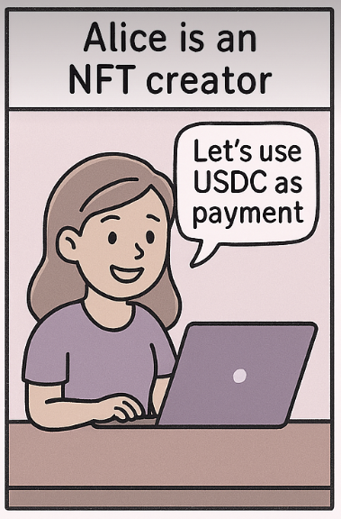
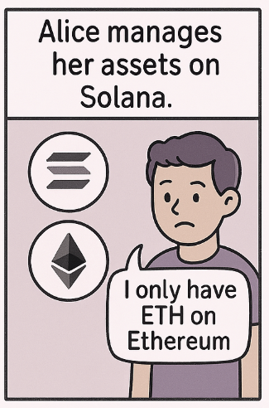
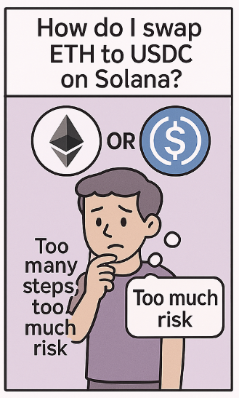
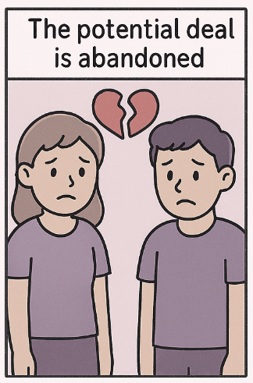
Scenario
Notes:
Here’s a common situation. Alice is an NFT creator and wants to be paid in USDC on Solana.
But Bob, her buyer, only has ETH on Ethereum. He doesn’t know how to bridge, swap, or even if it’s safe to try.
The result? The deal falls apart — not because of value, but because of friction. Intent Pay solves exactly this problem.

Slide 3
The Problem
Web3 is too complex for the average user
Wallet setup & gas tokens are major barriers
Cross-chain swaps require multiple tools
Users fear getting scammed or making mistakes
Notes:
Here is the problem, Web3 is still too complicated for beginner.
Setting up wallets, managing gas tokens, and swapping across chains require multiple steps and tools.
And worst of all, people are scared they’ll make a mistake or get scammed. These are the real barriers to mainstream adoption.

Slide 4
Our Solution
WorldWallet: Personal wallet that’s created automatically when you verify your identity with World App.
IntentPay: Lets users send crypto payments or buy tokens without needing gas token or understanding blockchains.
Notes:
Our solution has two parts.
WorldWallet is a personal wallet that’s created automatically when you verify your identity with World App
IntentPay lets users send payments or buy tokens without needing gas token at all.
Just choose what you want to send — we handle the rest: swapping, bridging, and delivery.

Slide 5

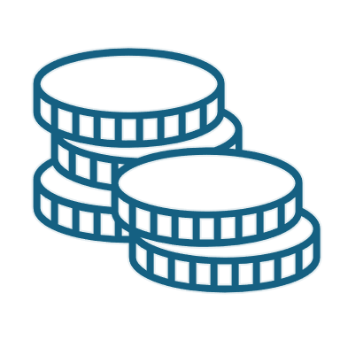
How It Works
Pay USDC/WLD
World Payment
Apple Pay
User-side
Developer-side
Wallet
(World Chain)
Smart treasury + route optimization engine
Circle Paymaster
(Base)
CCTP v2
1inch Fusion+
Notes:
Technically, the backend is powered by Circle Paymaster, with CCTP for cross-chain USDC, and 1inch Fusion+ for optimal swaps.
But none of this complexity is exposed to users.
We’ve designed a smart routing engine that makes the best decisions automatically — while keeping the experience simple and safe.

Slide 6

User Journey: IntentPay
Authenticate with World App
Pick destination chain/token
Enter recipient
No Wallet Needed
Pay with WLD or USDC
Cross-Chain
Token-less for You
Simple UX
Pay with WLD/USDC.e
System auto-swaps, routes, and delivers
Notes:
Now, instead of walking through every step here, I’m going to show you Intent Pay journey — live in the demo.
You’ll see how easy it is to make a cross-chain payment with no wallet, and how a user can instantly onboard into DeFi with just USDC.
So keep these flows in mind as we head into the demo
Here’s how Intent Pay works in real life:
You authenticate with World App, pick a destination token and chain, enter the recipient address, and pay with WLD or USDC.
That’s it. Behind the scenes, we handle the swap, routing, gas, and delivery — across chains. The user only sees a simple, clean interface.

Slide 7

Demo Time
Notes:
That’s how Intent Pay works — simple, secure, and chain-agnostic.
Now it’s time to show you the product in action.
I’ll walk you through a live demo of both Intent Pay and Intent Wallet, so you can see how effortless DeFi can truly be.

Slide 8
Re-Balancing
1inch selects a different chain for the best swap route
Base
CCPT v2
ETH
Avax
Notes:
In a multi-chain system like IntentPay, we hold USDC across chains like Ethereum, Base, and Avax. But user demand varies — one chain may get heavy usage while another sits idle. Sometimes, 1inch selects a different chain for the best swap route. To ensure smooth execution, we rebalance USDC across chains using CCTP, so every chain has enough liquidity when needed.

Slide 9
Q1: What inspired your project?
We started with a simple observation:
Most people don't use DeFi — not because they don't want to, but because it’s too complicated. Wallet setup, gas tokens, bridging, token swaps — these steps create friction and fear. We asked ourselves: “What if users didn’t need to know any of that? ”That’s how IntentPay was born: a way to let anyone interact with DeFi by just saying what they want to do, and letting the system handle the rest.

Slide 10
Q2: What tools did you use, and why?
We choose
World App provides human identity (World ID) and authentication
1inch Fusion+ gives us MEV-protected token swaps
Circle Modular Wallet lets us create wallets and pay gas with USDC
CCTP v2 powers fast, secure cross-chain USDC transfers for Re-balancing our PayMaster account
All of these tools work together to remove friction, without compromising on security or decentralization.
Notes:
“MEV protection means your swaps are executed fairly, without bots stealing value from your transaction. It’s like private checkout for DeFi.”

Slide 11
Q3: What challenges did you solve, and how?
We faced two major challenges while building IntentPay.
The first was chain and tooling compatibility. 1inch only supports swaps on mainnet, so we had to specifically apply for access to Circle Modular Wallet infrastructure on mainnet, just to make those trades possible.
At the same time, CCTP v2, which we use for cross-chain USDC, works well — but its supported chains don’t yet support Circle Paymaster, which we rely on for gasless transactions.
That meant we had to custom-handle chain-by-chain routing, separating the logic for Paymaster-supported chains and non-supported ones. It added a lot of complexity — but once those technologies roll out across more chains, the whole service will become smoother and more unified.
The second challenge was documentation. With limited time during the hackathon and some tools still in beta, documentation was either outdated or missing.
We had to rely heavily on trial and error, reading code examples, and reverse-engineering endpoints just to get some key features to work.
But we pushed through, and now we have a working demo across multiple chains — with a clear path to production once the ecosystem catches up.

Slide 12
Now we will demo rebalance technic
In a multi-chain system like IntentPay, we hold USDC across chains like Ethereum, Base, and Arbitrum. But user demand varies — one chain may get heavy usage while another sits idle. Sometimes, 1inch selects a different chain for the best swap route. To ensure smooth execution, we rebalance USDC across chains using CCTP, so every chain has enough liquidity when needed.

Slide 13
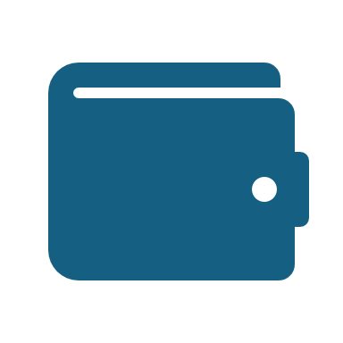
User Journey: IntentWallet
Authenticate with World App
Modular Wallet created
Fund with USDC
Self-custodial:
No passwords
Gas-free
Multi-chain ready
Swap, transfer, use DeFi
Gas-free + cross-chain ready
Notes:
Now, instead of walking through every step here, I’m going to show you these two journeys — Intent Pay and Intent Wallet — live in the demo.
You’ll see how easy it is to make a cross-chain payment with no wallet, and how a user can instantly onboard into DeFi with just USDC.
So keep these flows in mind as we head into the demo
For more advanced users, Intent Wallet is created automatically with your World App login.
You fund it with USDC, then use it to swap, transfer, and interact with DeFi.
It’s self-custodial, gas-free, and multi-chain — but still passwordless and easy to manage.

Slide 14
IntentPay
No Wallet Needed: You don’t need MetaMask or Phantom. It just works inside World App.
Pay with WLD or USDC: Use tokens you already have from World App
Cross-Chain: Works across Ethereum, Base, Arbitrum, Solana, etc.
Token-less for You: You don’t need to have gas tokens like ETH or MATIC
Simple UX: Just choose what to send and to whom. No blockchain knowledge required

Slide 15
IntentWallet
Self-custodial: The user owns the wallet — it's not held by a company.
No passwords: Authenticated using World App identity (Wallet Auth via SIWE)
Gas-free: All transactions use USDC (via Circle Paymaster), no need to hold ETH/MATIC/etc.
Multi-chain ready: Works across Base, Arbitrum, Avalanche, etc.

Slide 16
Business Model

Slide 17
Vision
我們正在打造一套基於 World App mini-app 生態系 的「Intent-based 跨鏈支付模組」，透過 1inch 聚合 DEX、跨鏈協議 CCTPv2 與 Circle Modular Wallet 技術，讓使用者在無需理解鏈與幣種的情況下，一鍵完成任何資產的任意支付，並實現自主資產管理。

Slide 18
World App Mini App + Intent Payment
我們透過 Worldcoin 的 Mini App 架構，實作一個原生整合的 World Payment 體驗入口。
使用者只需發出簡單「Intent（支付意圖）」，例如：「我要用我有的資產，支付 10 USDC 給某個 Solana 地址」系統自動處理：跨鏈、換幣、發送，無需用戶理解所持資產與目標資產是否在同一鏈上。

Slide 19
1inch 聚合器 + CCTP V2
多鏈最佳化 Intent Pay
我們作為中介撮合者，整合：
1inch 聚合器：找出最佳交易路徑與價格（支援多鏈 DEX）
Circle CCTP V2：用於精確、高安全性地橋接 USDC 到目標鏈
這樣就能讓用戶用任意資產（ETH、ARB、MATIC、BNB 等）支付給任意鏈上收款人（例如 Solana 上的 meme 幣），無需自己做換幣與橋接操作。
我們在過程中收取微薄手續費（例如 0.3~0.5%），作為 Intent 撮合與執行服務費。

Slide 20
Circle Modular Wallet
跨鏈資產統一檢視（即使資產散落各鏈）
可與 World ID 綁定實名／人類身份，提升安全與信任
這讓用戶不再需要記住多條鏈的私鑰、助記詞，也不怕資產遺失或遺忘
Intent Wallet

Slide 21
用戶零感知、多鏈任意支付 不懂鏈、不懂幣也能完成支付
Intent 撮合 + 最佳價格執行: 結合 1inch + CCTP 的路由與效率
資產由 Modular Wallet 管理: 提供安全、可擴展、可與 World ID 整合的錢包方案
商業模式: Intent 撮合收取低額手續費，按交易量穩定營收

